Slide 1
BIOMARKER

Slide 2
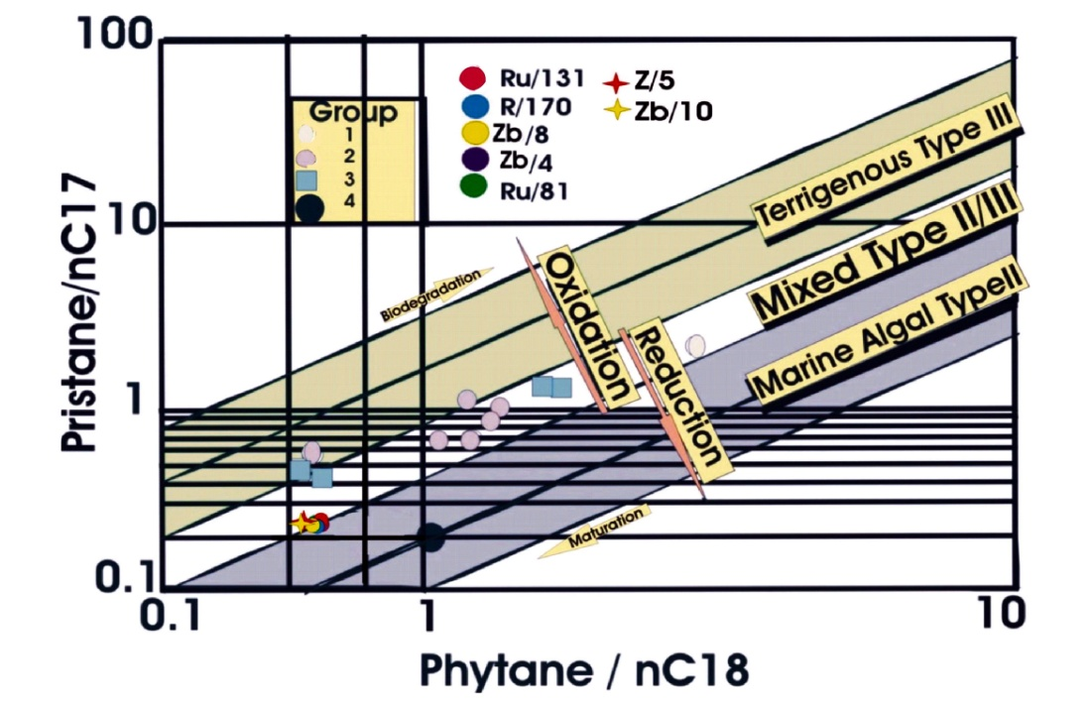

Slide 3
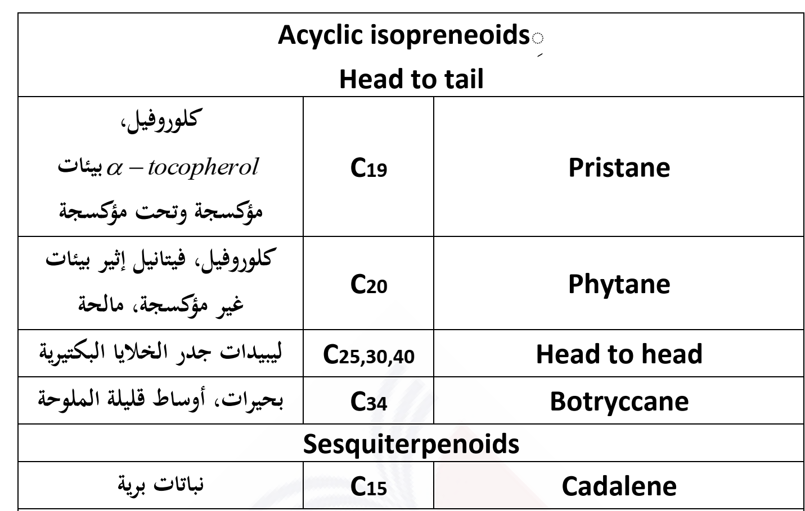

Slide 4
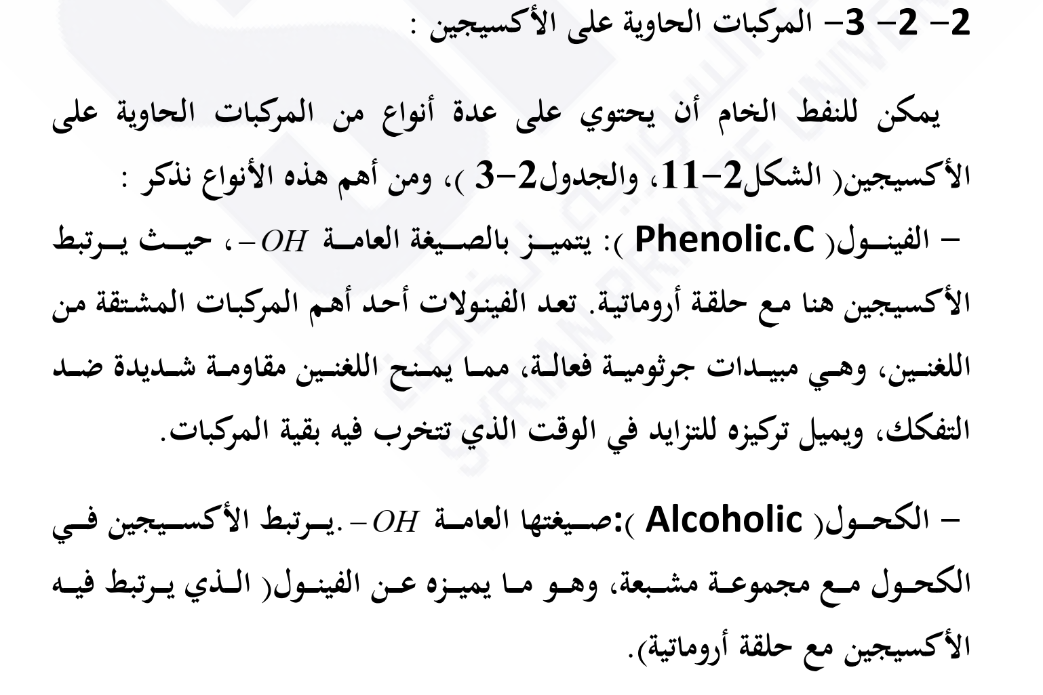
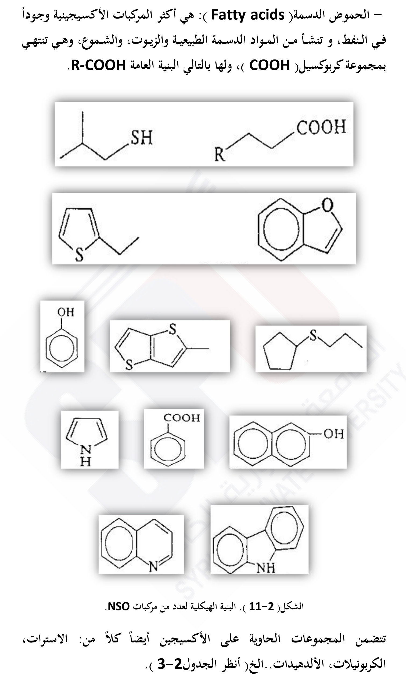

Slide 6
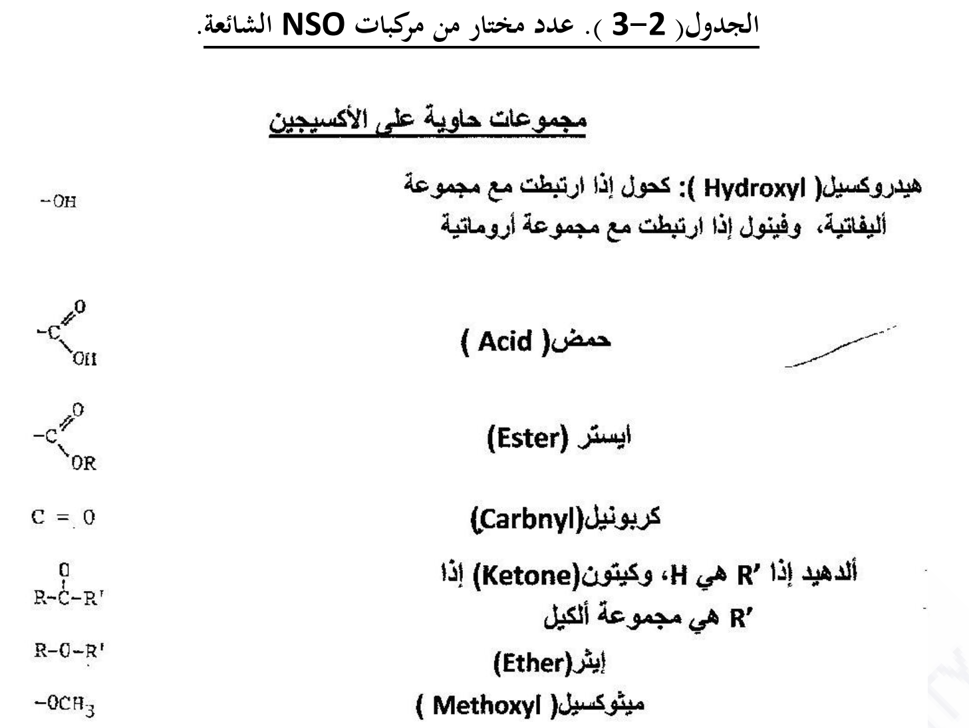

Slide 7
Terpanes
Abroad class of complex branched, cyclic alkanes biomarkers, including hopanes and tricyclic compounds, commonly monitored using m/z 191 mass chromatograms.
The term Terpanes originates from turpentine, the so-called “resin of pine trees’ is the viscous pleasantly smelling balsam which flows upon cutting or carving the bark and the new wood of several pine tree species (pinaceae). Turpentine contains the ‘resin acids’ and some hydrocarbons which were originally referred to as terpenes. Traditionally, all nature compounds built up from isoprene subunits and for the most part originally from plants are denotes as terpenes about 30.000 terpenes are known at present their basic structure follow a general principle

Slide 8
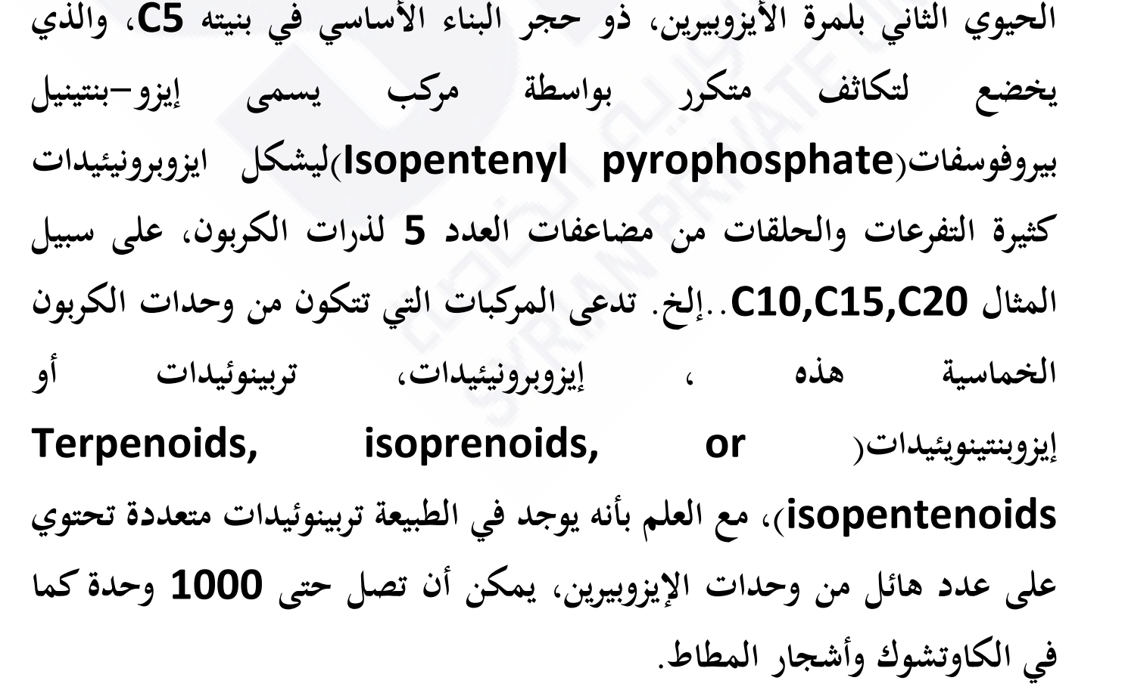

Slide 9
2-mathylbutane residues, less precisely but usually also referred to as isoprene units, (C5)n, build up the carbon skeleton of terpenes. Therefore, terpenes are also denoted as isoprenoids. In nature, terpense occur predominantly as hydrocarbons, alcohols and their glycosides, ethers, aldehydes, ketones, carboxylic acids and esters. Triterpanes and steranes (C30) differ in structure and composed of six isoprene subunits, while tetraterpanes (C40) contain eight saturated terpanoids with nine or more isoprene units (C45+) which called polyterpanes. Many terpanes in petroleum originate from bacterial (prokaryotic) membrane lipids (Ourisson et al., 1982). The terpenoid families are composed of a wide variety of cyclic and acyclic structures (Simoneit, 1986). Some of which are: hemiterpenes (C5), monoterpanes (C10), sequiterpanes (C15), diterpanes (C20) and sesterterpanes (C25) contain one, two, three, four, and five isoperene subunits, respectively (Peter et al., 2005).

Slide 10
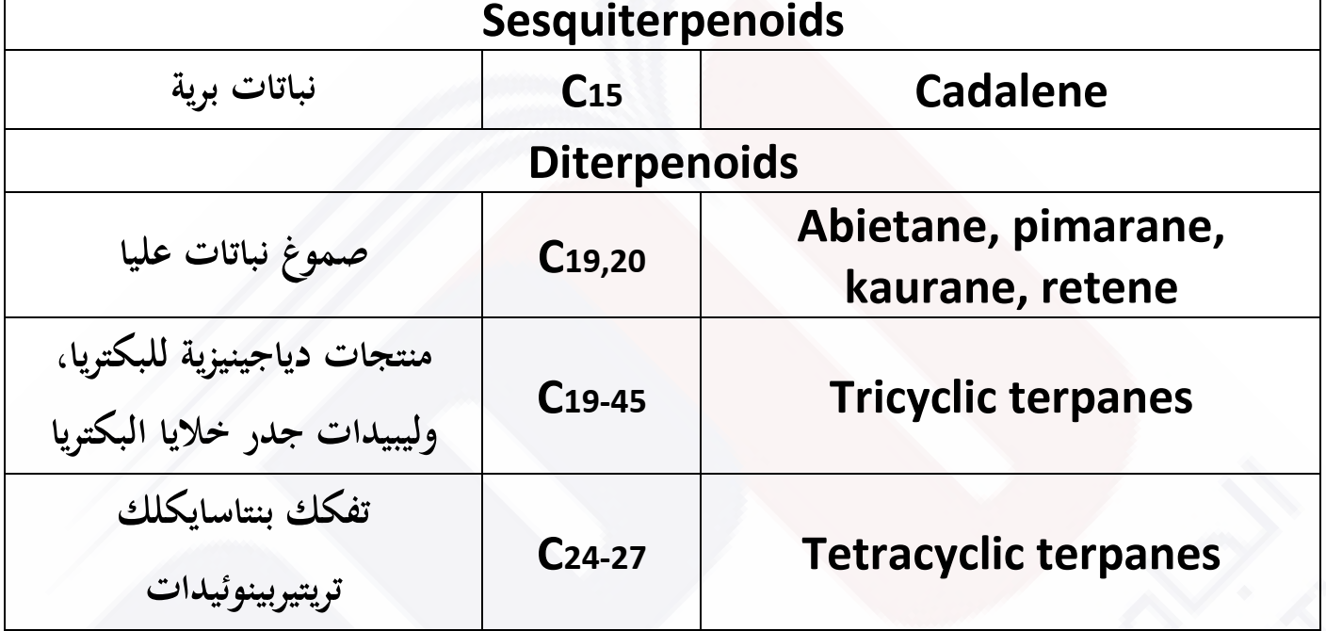

Slide 11
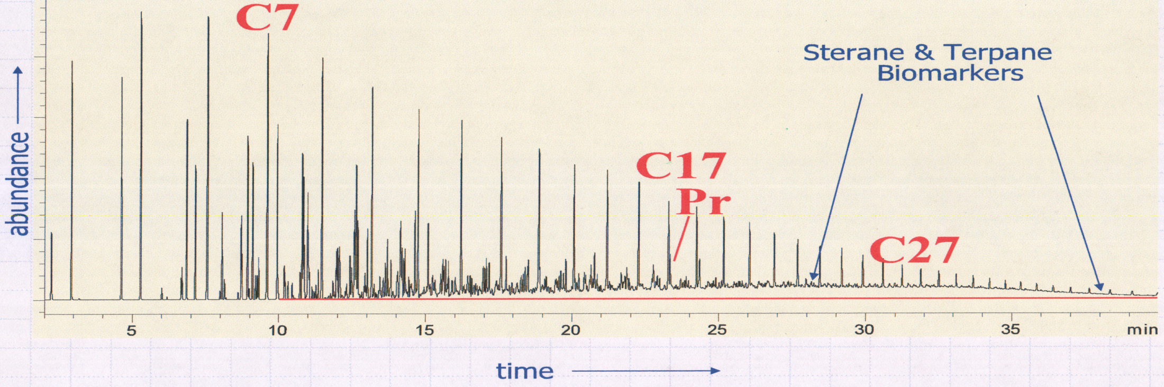
Whole Crude Gas Chromatogram
An analytical technique designated to separate compounds, whereby a mobile phase (inert carrier gas) passes through a column containing immobile stationary phase (high-molecular-weight liquid. The stationary phase can be coated on the walls of the column or on a solid support packing material.
Compounds separate based on their relative tendencies to partition into the stationary or mobile phases as they move through the column. Various detectors can be used to measure the separated component as they elute from the column. Most gas chromatographs are equipped with flame ionization detector (FIDs).

Slide 12
Tricyclic Terpanes
Tricyclic terpanes or chelianthanes were first observed in extracts from Green River Formation (Anderson and Robinson, 1971). The tricyclic terpanes occur in the C19-C45 range. The most prominent tricyclic terpanes (14-alkyl, 13-methly podocarpanes) range from C19 to at least C54 and are important components in the saturated hydrocarbon fractions of petroleum (Moldowan et al., 1983). The precursors compounds for these tricycylics is still unknown although evidence currently points in favor of their origin from organism that inhabits saline rather than fresh water environments. The tricyclic terpanes have two stereochemical centers in the ring where the H atoms can exist either in the α or β configuration. The most abundant isomer in oil and source rocks samples is ββ, 14α isomers (Philip, 2007).

Slide 13
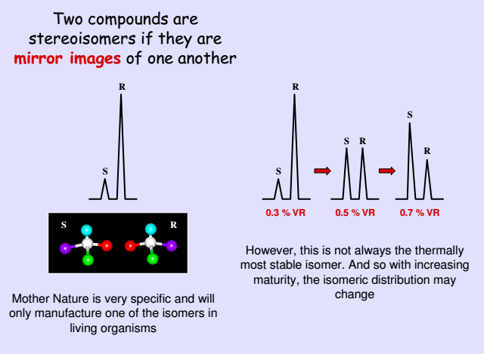

Slide 14
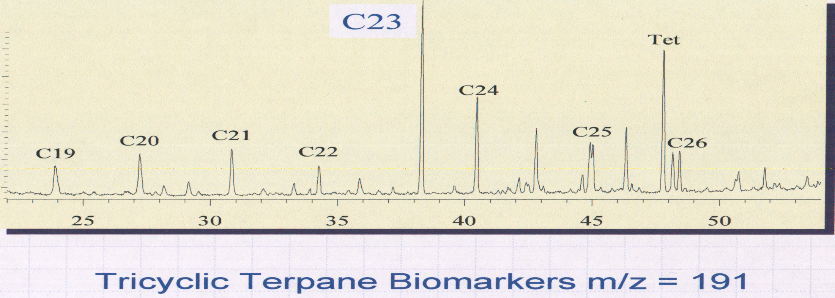
GC/MS Mass Chromatogram
The most prominent tricyclic terpanes (cheilanthanes, 14-alkyl-13-methylpodocarpanes) range from C19 to more than C54 and consist of three six-member rings with an isoprenoid side chain.
Abundant tricyclic terpanes commonly correlate with high paleolatitude Tasmanites-rich rocks, suggesting an origin from these algae, although other sources are possible.
Tricyclic terpanes/hopane increases with thermal maturity of petroleum.

Slide 15
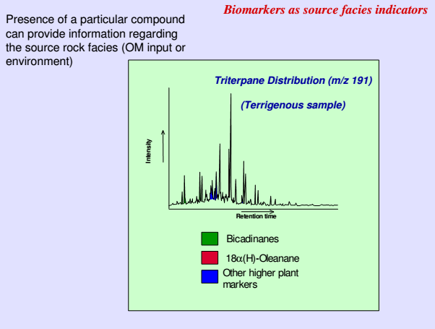

Slide 16
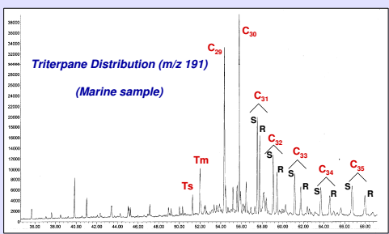

Slide 17
Tricyclic terpanes are used to correlate crude oils and source-rock extracts, predict source-rock characteristics and evaluate the extent of thermal maturity and biodegradation In order to know the type of source rock there are many parameters as described below:
1- Tricyclic terpanes ratio (C22/C21): C24/C23 and C26/C25)
Ratios of various tricyclic terpanes by carbon number can be useful in order to distinguish marine, carbonate, lacustrine, coal/resine, and evaporitic oils measured using M/Z191 fragmentogram (Peters et al., 2005) M/Z (mass/charge) ratio of anion in mass spectrometry measured in units of Daltons/Charge)

Slide 18
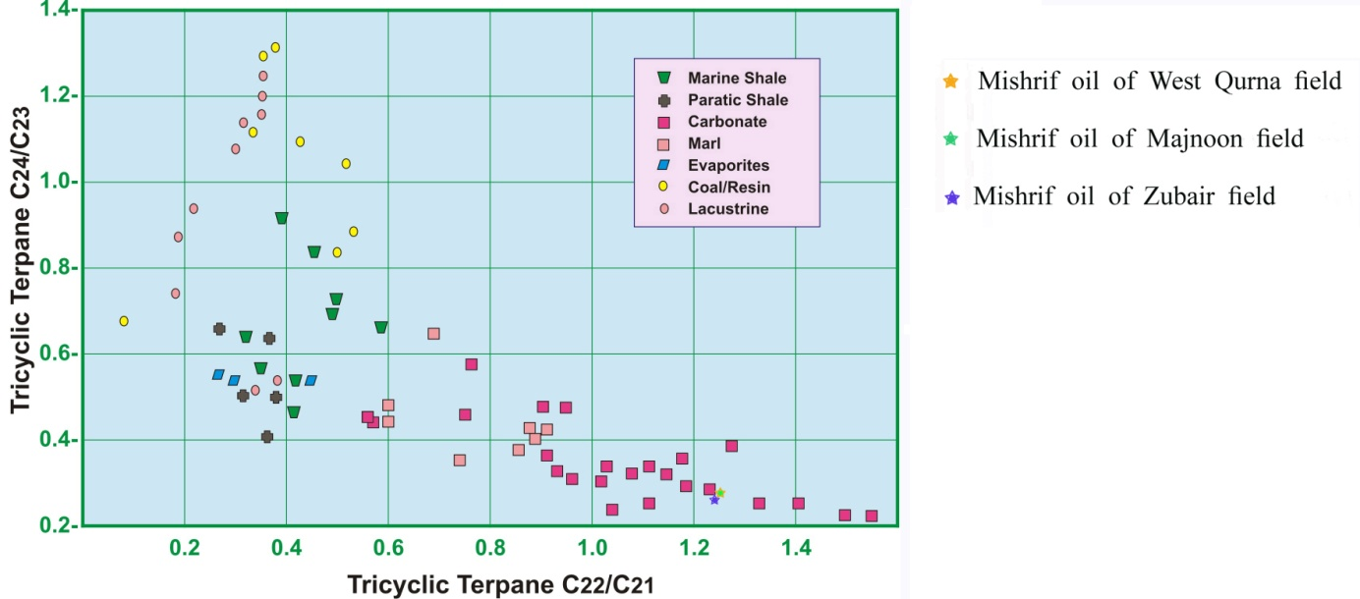

Slide 19
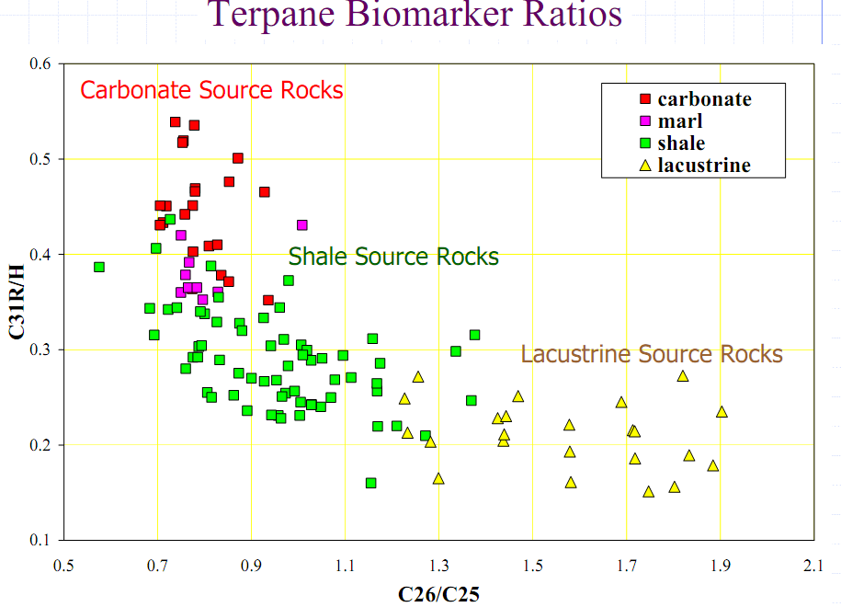

Slide 20
Tetracycic Terpane
Tetracyclic terpane of the 17, 21. secohopane series are structurally similar to hopane (Trendel et al., 1982). Tetracyclic terpane occurs in most oil and rock extracts. The C24-C27 tetracylci terpanes appear to be more resistance to biodegradation and maturation than the hopanes (Peters et al., 2005). Ratio of tetracyclic terpanes to hopanes increase in more mature source rock and oils indicating greater stability of tetracyclic terpanes (Peters et al., 2005). Tricyclic and tetracyclic terpanes ratios are commonly used as correlation parameters (Peters and Moldown, 1993).
The C25-C27 tetracyclic terpanes have been reported in carbonate and evaporate samples (Connan et al., 1986). The C24 tetracyclic terpane/hopane, C24 tetracyclic/C23 triccyclic terpane and C24 tetracyclic/C26 tricyclic terpane ratio are common source rock parameters

Slide 21
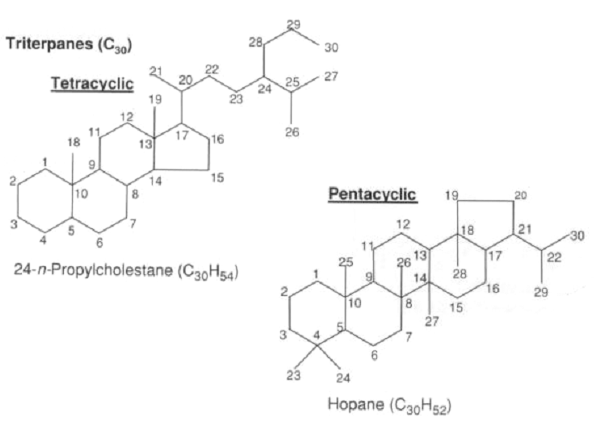

Slide 22
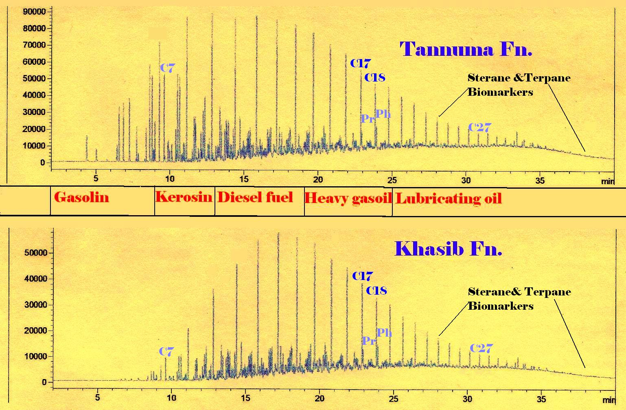

Slide 23
Hopanes
Hopanes were among the first group of compounds to be utilized in petroleum geochemistry (Philip, 2007). The hopanes composed of three stereo isomeric series namely 17α, 2β-, 17β, 21β-, and 17β, 21α(H)- hopanes (Peter et al., 2005).
Virtually all of the precursors of the hopanoids can be associated with a bacteria or prokaryltic origin. The hopanes generally occur in the C27-C35 range although there is evidence to show that they actually extent to significantly higher carbon number, the hopanes are not particularly as useful as source indicators due to their ubiquity (Philip, 2007). The families of hopanes include groups of compounds:

Slide 24
1) Regular hopanes
Seifert and Moldowan (1978) described the hopane distributions and specifically discussed the two of C27-trisnorhopanes namely Ts and Tm {Ts: C27 18α-trisnorhopane II; and Tm: C27 17α-trisnorhopane}. The ratio of Ts/Tm uses maturity indicator. If we have two samples that come from common source then this ratio can be used to indicate maturity differences. If we have oils which are of the same maturity then differences in this ratio will indicate differences in source or depositional environments (Moldown et al., 1985).
The ratio Ts/Tm of two C27 hopanes (18α-22, 29, 30-trisnorhopane-II (Ts)) and 17α-22, 29, 30-trisnorhopane (Tm); Ts/Ts+Tm and Ts/Tm depend on both source and maturity (Moldowan et al., 1986). Oils form carbonate source rocks have anomalously low ratios compared with those from shale (Hunt, 1996). The values of ratio Ts/Tm

Slide 25
Other compounds the extended hopanes or homohopanes C31-C35 are probably related to specific bacteriohopanepolyols found in bacteria such as bacteriohopanetertol (Peters and Moldown, 1991). The bacteriohopanetetrol can also incorporated into kerogen and later released during catagenesis (Mycke et al., 1987). Distribution of 17α(H), 21β(H)-homohopanes in petroleum derived from marine organic matter are used to evaluate the environment of deposition of the organic matter their source rock (Peters and Moldown, 1991). In other development, where the relative concentration of the C35 extended hopanes, are greater than the C34 compounds, that are indicator the oils derived from carbonate source rocks (Philip, 2007).

Slide 26
The distribution of C31-C35-17α(H), 21β (H) 22S and 22R homophopane in marine petroleum have been used as indicators of the redox potential (Eh) during and after deposition of the source rock sediments (Moldowan et al., 1989; Schoell et al., 1991).
The C35-homohopane index is the ratio of C35/(C31-C35) homohopane usually expressed as percentage (Peters and Moldowan, 1991). The high C35 homohopanes indices are typical of marine low Eh environment of deposition (Peters and Moldowane, 1991). C35-homohopane index indicator of redox potential in marine sediments during diagenesis, high values indicate anoxia, but also affected by thermal maturity, measured from M/Z 191 chromatograms and expressed as C35/C34 and C35S/C34S hopanes (Peters et al., 2005). The C29/C30 and C35/C34 hopane ratio can be used to define the source facies of oils (Peters et al., 2005), Peters et al. (2005) suggested that ratio of C35-S/C34H is greater than 0.8 and ratio of (C24/C30H)>0.6 that indicator to marine carbonate source rocks Peters and Moldowan (1991) proposed that a high C35homohopane index and low Pr/Ph value indicate reducing but not necessary hypersaline conditions. The other ratio is C31/C30 hopane which is a useful index to distinguish between marine versus lacustrine source rock deposition environments. This ratio is expressed as C31 22R/C30 hopan (C31R/H)

Slide 27
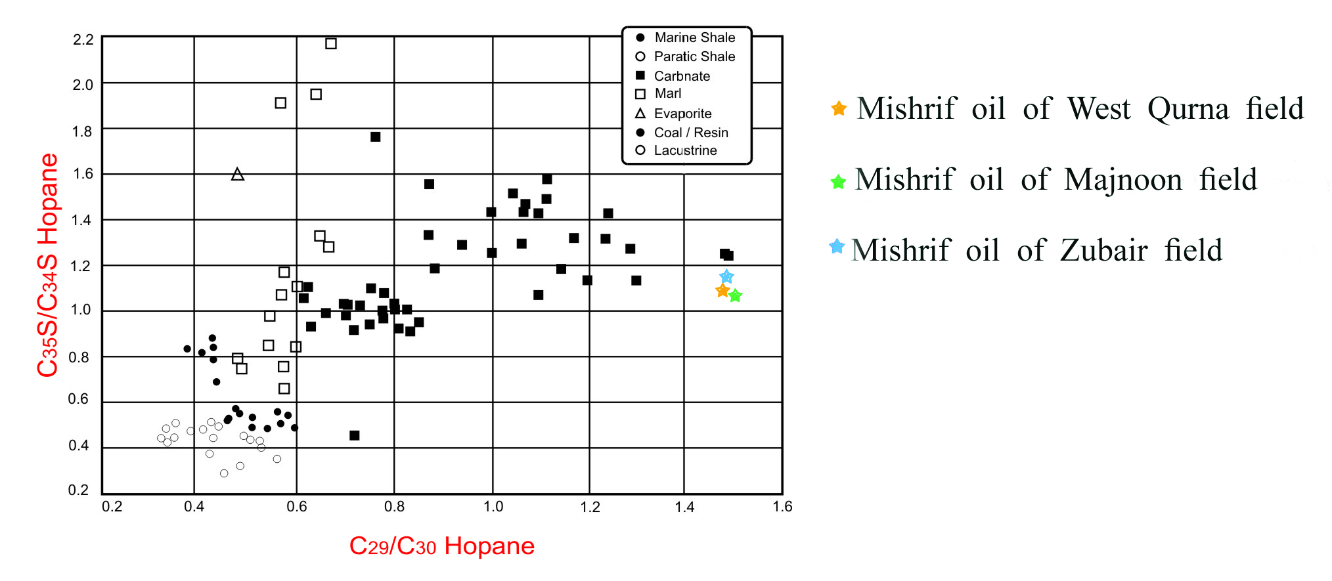

Slide 28
This ratio is useful to know the marine and lucastrine crude oil in combination with other parameters such as C26/C25 tricyclic terpane and the coaonical variable(C.V.) from stable carbon isotope measurements,

Slide 29
2) 28-30-Bisnorhopane
(BNH or 28-30DNH) adesmethyl hopane (two methyl groups removed compared with hopane) that contains 28 carbon atoms and is common in sulfur-rich source rocks also called 28-30-NNH and 28, 30-dinorhopane (28, 30-DNH) (Peters et al., 2005). There are three possible isomers for this compound namely 17αH, 21βH; 17βH, 21βH; and 17βH, 21αH with the latter being the most abundant (Philip, 2007). Scolfield (1989) recently suggested a bacterial origin again for this compound. The ratio of 28, 30.Bsinorhopane and 25, 28, 30-trisnorhopanes highly specific as a correlation tool probable bacterial markers associated with some anoxic depositional environments also expressed as C28/H, BNH/H, TNH/H and BNH/TNH (Peters et al., 2005). High concentrations of BNH and TNH are typical of petroleum source rocks deposited under anoxic conditions. Abundant of BNH and TNH in oil indicates deposition of the source rock under clay-poor, anoxic conditions (Katz and Elrod, 1983).

Slide 30
3) 30-Norhopanes
This series reflects microbial activity during original period of deposition and is widely distribution in oils from carbonate source rocks (Suborto et al., 1991). The C30 30-norhhopane has a slightly longer retention time than the regular C30 hopane and then the higher homologues occur as a single peak since there are no 22S and 22R epimers in this series, it appears that the 30-nor-17α(H)-hopanes increase in concentrations relative to the 17α(H) hopanes with increasing maturity suggesting that they are preferentially bound into the kerogen or less readily released than the regular hopanes (Philip, 2007). The ratio of 30-Norhopanes/hopane is useful to be used for source rocks and environmental where high 30-nohopane is typical of anoxic carbonate or marl source rocks and oils, also expressed as C29/C30 hopane (C29/H) (Peters et al., 2005).
Norhopane is more stable than hopane at high levels of thermal maturity, thus, 30-norhopane/hopane can increase with thermal maturity (Peters et al., 2005).

Slide 31
4) Diahopanes
Several years ago the significant presence of a C30 terpane eluting between the C29 and C30 hopane in number of Australian crude oils lead to its tentative identification as compound X (Philip and Gilbert, 1986). This compound has now been identified as diahopane (Philip, 2007). The diahopaen actually occur as a series from C27-C35 although only the C30 compound has been unambiguously identified by isolation and NMR spectroscopy (Moldowan et al., 1991). These compounds are probably derived from bacteriohopanes and are more thermally stable than both neohopanes and regular hopanes (Philip, 2007). The ratio 17αDiahopane/18α-30-honeohop explain the probable relationship between and oxic-suboxic/ caly – rich depositional environments. It is measured by using m/z 191 chromatograms and by parents of m/z 191 using GCMS/MS; also expressed as C*3o/C29Ts (Peters et al., 2005). The originates from bacterial input to sediments containing clays deposited under oxic or suboxic conditions and the type of highly terrigenous oils (Philip and Gilbert, 1986). Application of the C*3o/C29Ts parameter is not well established (Peters et al., 2005). However, it appears that relative amounts of and C29Ts depend most strongly on environment of deposition and that oils derived from shales deposited under oxic-suboxic condition show higher ratios than those from source rock deposited under anoxic conditions (Peter et al., 2005).

Slide 32
Non-hopanoid terpanes
Non-hopanoid terpanes derived from higher plant source are for more abundant than the hopanoids in many oils from terrigenous source materials (Philip, 2007). Higher plant contain a wide variety of triterpenoids and many of their hydrocarbon derivations can be found in the corresponding oils and source rocks (White and Head, 1974 in Philip, 2007). The compounds are based on pentacyclic structures such as oleananes, lupanes, and ursanes along with their demethylated analogues (Philip, 200

Slide 33
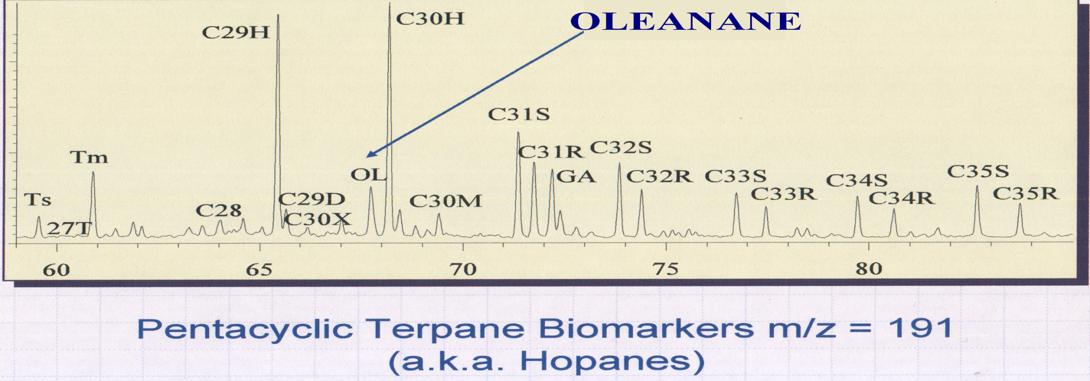
GC/MS Mass Chromatogram
Hopanes are pentacyclic triterpanes commonly containing 27-35 carbon atoms in naphthenic structure composed of four six member rings and one five-member ring. Hopanes originate from precursors in bacterial membranes. Hopanoids in these membranes,such as bacteriohopanetetrol, originate by cyclization of squalene precursors.
Include; Gammacerane (C30),Oleanane (C30), Hopane (C30H52), 28,30-Bisnorhopane (C28).

Slide 34
Oleananes (C30 triterpane marker of angiosperms)
Oleanance may be derived from a number of naturally occurring precursors, including taraxer – 14 – en - 3β - 01 and olean-12 – en - 3β ol, which through a series of complex reduction and isomerization reaction can produce two isomers of oleanane (Ten Haven and RullkÖter, 1988). Oleanane are formed in sediments through diagenetic and catagenetic alteration of various 3β functionalized angiosperm triterpenoids (Ten Haven and Rullkötter, 1988). Initially it was thought that the oleananes existed only one isomer in both oils and source rocks. However with good high efficiency capillary column it is possible to show that there are two isomers present in many of these samples namely the 18α(H) and 18β(H) isomers (Philip, 2007). The origin of vegetation containing 18α-oleanane precursor (basically angiosperms) is established at late cretaceous (Turonian) or younger (Peters and Moldowan, 1993). The α configuration is the most stable thermodynamically, thus, it is the predominant configuration in mature crude oils and rocks (Riva et al., 1998). The ratio of oleanane/30 hopane (17α-hopane is a bacterial marker. Oleanane index is a highly specific for higher-plant input of cretaceous or younger also expressed as OL/H or OL/(OL+H) (Peters at al., 2005).
Oleanance occurs mainly in late cretaceous or younger rocks, but its absence cannot be used to prove age

Slide 35
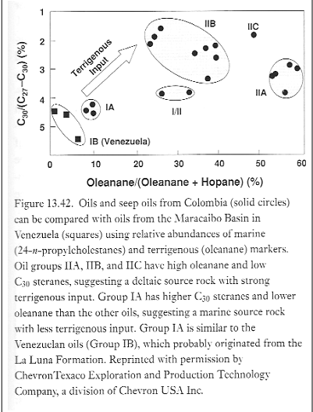

Slide 36
Gammacerane
A C30 pentacyclic triterpane with six-membered E-rings in which each ring contains six carbon atoms (Peters et al., 2005) source rocks deposited in straitified anoxis water columns (commonly hypersaline) and related crude oils commonly have high gammacerane indices (gammacerane/ hopane) (peters et al., 2005). A high content of gammacerane in source rock or oil is generally associated with hydpersaline depositional environment (Modldowan et al., 1985). Gammacerane index highly specific for water column stratification (commonly due to hydrpersalinity) during source – rock deposition, also expressed as 10∗gammacerane/ C31 22R hopane; and Ga/C31 R (Peters et al., 2005). The gammacerane can be found in all depositional environments, but the concentration of gammacerane increases with the rising salinity of water (FuJiamo et al., 1990). A maximum concentration of gammacerane is only found in hypersaline sediments (FuJiamo et al., 1990). It is believed that gammacerane is derived from protozoa (Hills et al., 1966). The principle characteristics of the biological marker of saline/hypersaline sediments extracts are a dominance of phytane and high content of gammacerane and abnormal distribution of homohopanes (Homohopane index >> 1) (Fu et al., 1990).

Slide 37
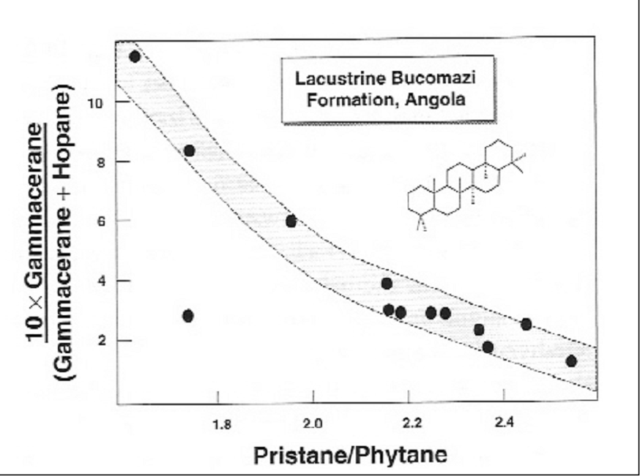

Slide 38
